Slide 1

Lesson 1:
Probability Introduction

Slide 2


Introduction

Slide 3

Lecture Overview:
Goals of the lecture:
Develop your probabilistic intuition to solve real-world problems

Slide 4
Probabilistic Intuition

Slide 5
Probability
Definition:
Probability is the study of theoretical possibilities and their likelihood of occurring

Slide 6
Testing your Probabilistic Intuition
Before we begin, let us test your intuition by discussing your perceived outcomes for a series of phenomena:
Example 1:
What is the probability of flipping heads with a fair coin?
What is the probability of getting a 1 or 2 with a fair die?
What is the probability of getting a Heart card from a 52 deck of cards?
1
2
3

Slide 7
Testing your Probabilistic Intuition
Before we begin, let us test your intuition by discussing your perceived outcomes for a series of phenomena:
Example 1:
What is the probability of flipping heads with a fair coin?
0.5
What is the probability of getting a 1 or 2 with a fair die?
2/6 = 1/3 = 0.33
What is the probability of getting a Heart card from a 52 deck of cards?
13/52 = 1/4 = 0.25
1
2
3

Slide 8
Definitions

Slide 9
Random Experiment
Definition:
Random Experiment is the process of observing a phenomenon that has an uncertain outcome. Random Experiments are unpredictable in the short term and predictable in the long term
Example 2:
Flipping a coin (the outcome is uncertain – we may get heads or tails). In the short term, the experiment is unpredictable (i.e. probability of heads is unknown), but in the long term, the experiment becomes predictable (i.e. probability of heads becomes roughly 0.5 if fair coin)
Rolling a 6-sided die (the outcome is uncertain – we may get 1,2,3,4,5,6). In the short term, we can’t predict if we get a 1, but in the long term, it converges to 1/6.
1
2

Slide 10
Sample Space
Definition:
Sample Space describes a list of all the possible outcomes of an experiment.
The Sample Space is typically denoted by Omega or S, enclosed in curly brackets and separated by commas: Ω = {Outcome_1, Outcome_2, Outcome_3, …, Outcome_n}
Example 3:
1. A fair coin has a sample space of {H, T}
2. A 6-sided die has a sample space of {1, 2, 3, 4, 5, 6}
3. Sentiment Analysis has a sample space of {“Positive”, “Negative”, “Neutral”}
4. A pregnancy test has a sample space of {“Pregnant”, “Not Pregnant”}
1
2
3
4

Slide 11
Random Experiment Outcomes
Definition:
The Outcome of a Random Experiment is simply the result that is obtained after running the experiment
Example 4:
We can flip a coin and observe the outcome as “Heads”
We can roll a die and observe the outcome as “5”
We can choose a card from a 52-card deck and observe the outcome as “Ace of Spades”
We can interpret the sentiment of a corpus of documents and observe the outcome as “Positive”
We can run a pregnancy test and observe the outcome as “Not Pregnant”
1
2
3
4
5

Slide 12
Events of a Random Experiment
Definition:
The Events of a Random Experiment are subsets of the outcomes in the Sample Space that we are interested in observing.
Example 5:
While a Sample Space of rolling a 6-sided die may contain all the numbers between 1 – 6, we may actually only be interested in the even numbers. Therefore, S = {1,2,3,4,5,6}, but E = {2,4,6}
While a Sample Space of a 52-card deck may contain all the combinations of 2-10,J,Q,K,A with the 4 suits, we may actually only be interested in the 4 aces. Therefore E = {A_spades, A_hearts, A_clubs, A_diamonds}
1
2

Slide 13
Problem 1
Problem 1:
If a Random Experiment consists of flipping a coin twice:
What is the Sample Space of this experiment?
What are the possible events where the first toss results in a Heads?
*Assume that the coin consist of two sides – “Heads” and “Tails”

Slide 14
Problem 1
Solution 1:
The Sample Space of the Random Experiment described above is:
S = {TT, TH, HT, HH}
The events of the experiment where the first toss results in a Heads is:
E = {HT, HH}

Slide 15
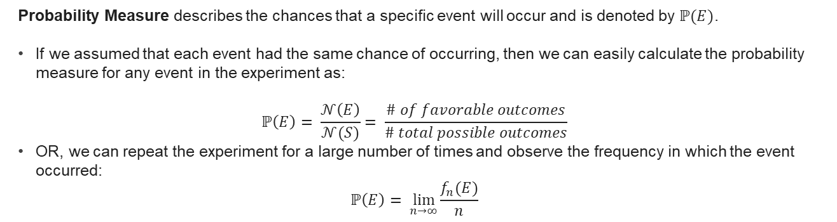
Probability Measure
Definition (1):
Probability Measure describes the chances that a specific event will occur and is denoted by $ℙ(E)$.
If we assumed that each event had the same chance of occurring, then we can easily calculate the probability measure for any event in the experiment as:
$$ℙ\left(E\right)= \frac{𝒩\left(E\right)}{𝒩(S)}= \frac{\# of favorable outcomes}{\# total possible outcomes}$$
OR, we can repeat the experiment for a large number of times and observe the frequency in which the event occurred:
$$ℙ\left(E\right)= \lim_{n→∞}{\frac{f_{n}(E)}{n}}$$

Slide 16
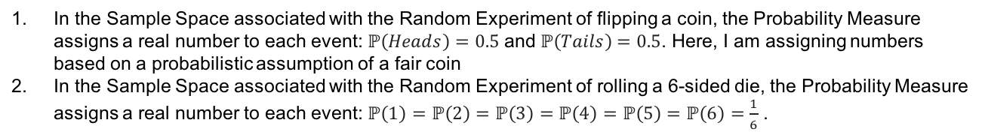
Probability Measure
Definition (2):
The Probability Measure assigns a real number to each Event
The probability of an event will have a value between 0 and 1
The sum of the probabilities of the sample space is equal to 1
Example 6:
In the Sample Space associated with the Random Experiment of flipping a coin, the Probability Measure assigns a real number to each event: $ℙ\left(Heads\right)=0.5$ and $ℙ\left(Tails\right)=0.5$. Here, I am assigning numbers based on a probabilistic assumption of a fair coin
In the Sample Space associated with the Random Experiment of rolling a 6-sided die, the Probability Measure assigns a real number to each event: $ℙ\left(1\right)=ℙ\left(2\right)=ℙ\left(3\right)=ℙ\left(4\right)=ℙ\left(5\right)=ℙ\left(6\right)=\frac{1}{6}$ .
1
2

Slide 17
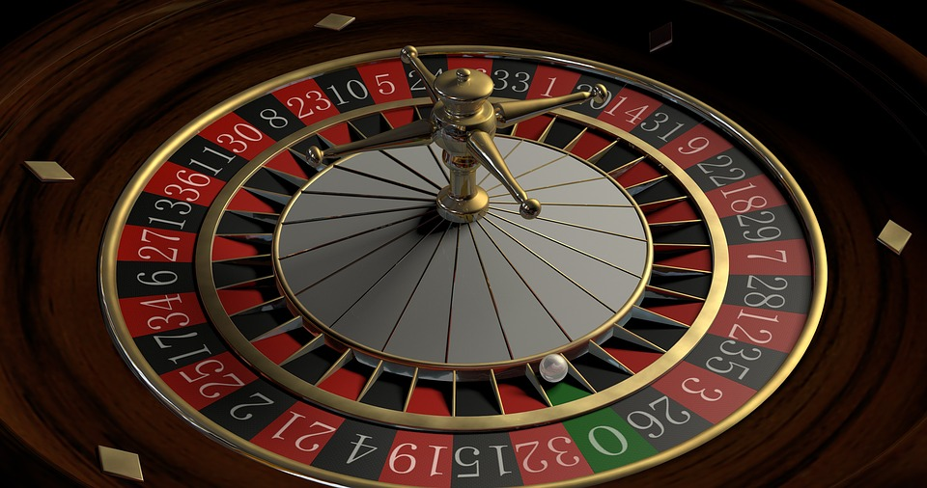
Problem 2
Problem 2:
A roulette wheel has 37 numbers. 18 numbers are red, 18 numbers are black and 1 number is green.
What is the probability of getting a red number?
What is the probability of getting a black number?
What is the probability of getting a green number?

Slide 18
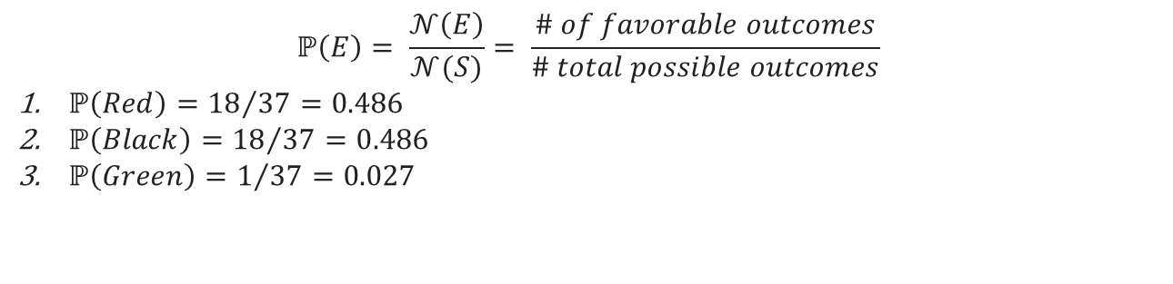
Problem 2
Solution 2:
$$ℙ\left(E\right)= \frac{𝒩\left(E\right)}{𝒩(S)}= \frac{\# of favorable outcomes}{\# total possible outcomes}$$
$ℙ\left(Red\right)={18}/{37}=0.486$
$ℙ\left(Black\right)={18}/{37}=0.486$
$ℙ\left(Green\right)=1/{37}=0.027$

Slide 19
QUESTIONS?

